Slide 1
Welcome
Department of Computer Application’s
KIET Group of Institutions
Delhi-NCR, Ghaziabad

Slide 2
Project Title
QUIZATO

Slide 3
Team Members Ayushi Srivastava-1900290140011
Team Details- QUIZATO
Team Leader
Ravindra Yadav-1900290140027
Project Supervisor-
Dr. Vipin Kumar

Slide 4
Introduction
This is an online quiz web application.
The main aim of our online quiz is to facilitate a user friendly enviornment.
There are many online quiz web applications are available on internet and they also provide study material for quiz but in this app we are providing quizzes only and when user will submit the quiz, he will get his correct answers as well as +1 extra point.
In this application we will provide technical subject’s quizzes
like HTML, CSS,PHP, JavaScript, Data Structure , DBMS etc.

Slide 5
Users in Online Quiz
Students
Teachers
Admin

Slide 6
Requirement
HTML
CSS
JavaScript
Bootstrap
JQuery
Json Server

Slide 7

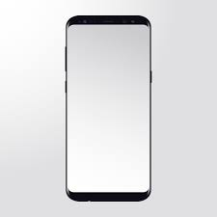
Hardware
Laptop
Core-i3/Core-i5
RAM-4Gb
Mobile-phone

Slide 8

Software
Virtual Studio Code

Slide 9
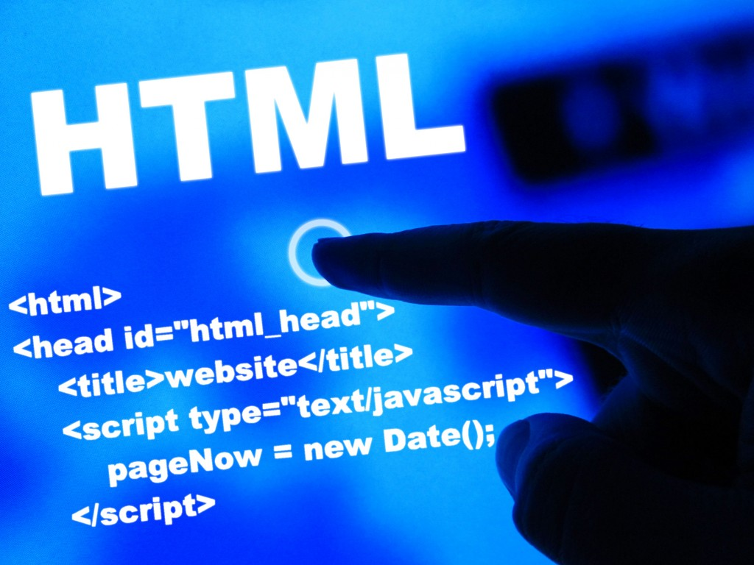
HTML
HTML5 is a markup language used for structuring and presenting content on the World Wide Web. It is the fifth and last[
It is the fifth and last major HTML version.
HTML stands for Hyper Text Markup Language
HTML is the standard markup language for creating Web pages
HTML describes the structure of a Web page
HTML consists of a series of elements

Slide 10

CSS
CSS stands for Cascading Style Sheets
CSS describes how HTML elements are to be displayed on screen, paper, or in other media
CSS saves a lot of work. It can control the layout of multiple web pages all at once
External stylesheets are stored in CSS files

Slide 11
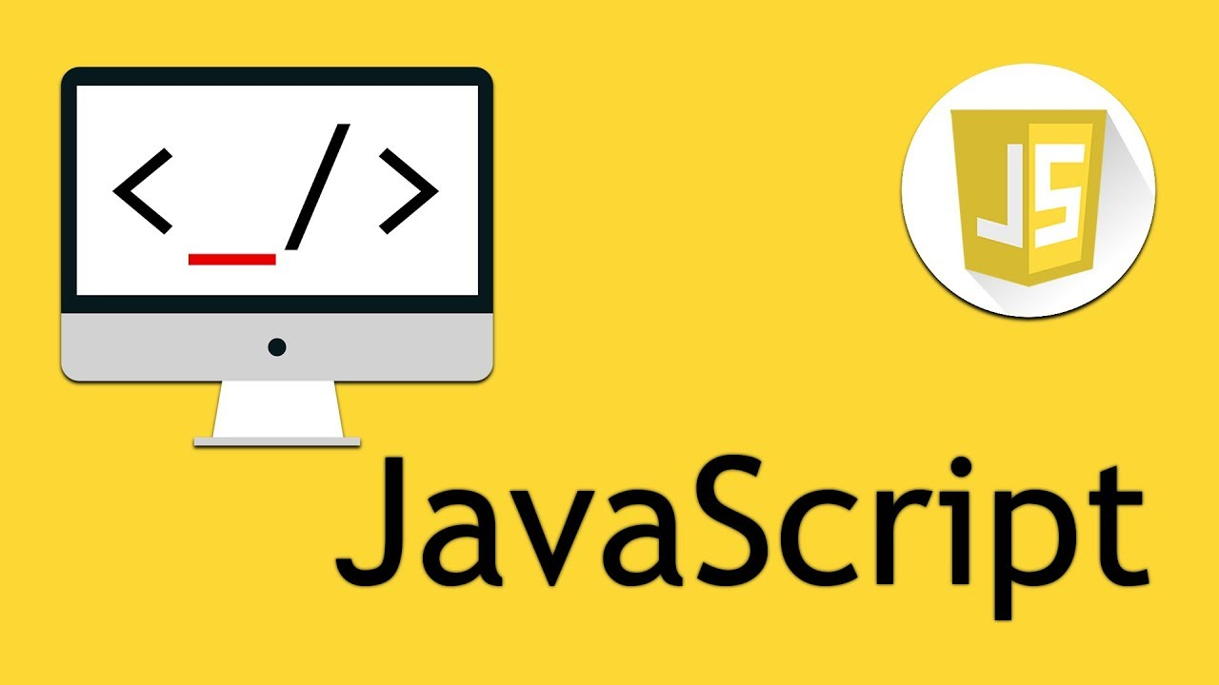
JavaScript
JavaScript is a dynamic computer programming language.
It is lightweight and most commonly used as a part of web pages, whose implementations allow client-side script to interact with the user and make dynamic pages.
JavaScript was first known as LiveScript, but Netscape changed its name to JavaScript, possibly because of the excitement being generated by Java. JavaScript made its first appearance in Netscape 2.

Slide 12

Bootstrap
Bootstrap is the most popular HTML, CSS and JavaScript framework for developing a responsive and mobile friendly website.
It is absolutely free to download and use.
It is a front-end framework used for easier and faster web development.
It includes HTML and CSS based design templates for typography, forms, buttons, tables, navigation, modals, image carousels and many others.
It can also use JavaScript plug-ins.
It facilitates you to create responsive designs.

Slide 13
Modules Description
Making of Quiz
Taking of Quiz

Slide 14
Benefits
Large number
Taking online quizzes makes it possible to have a large number of participants. It could be up to a number of 1000 participants (and even more!). It doesn’t matter at what kind of location they take the online quiz as long as they are connected to the Internet.
Randomizing questions
It is significant more easy to randomize your question with just one click than to do it all manually. Besides the advantage of time saving, it also helps preventing students from cheating.

Slide 15
Benefits
No instructor needed
Quizzes can be given without an instructor, which saves money and time :)
Set timer
The user will be able to set a timer for the whole quiz or to set a timer per question. This is possible to do with written quizzes, but is very time consuming for the instructor. Plus it’s almost impossible to do with a huge amount of participants.
Better overview
It’s possible to show one question at the time with online quizzes. People are not able to skip a question, because you will get a reminder that you can’t leave the answer blank.

Slide 16
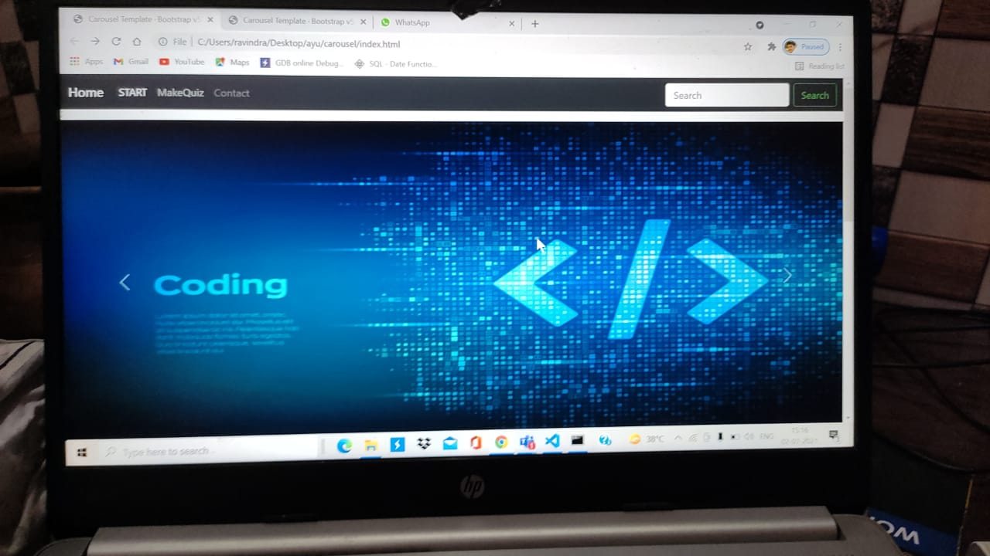
First Page of Quizato

Slide 17
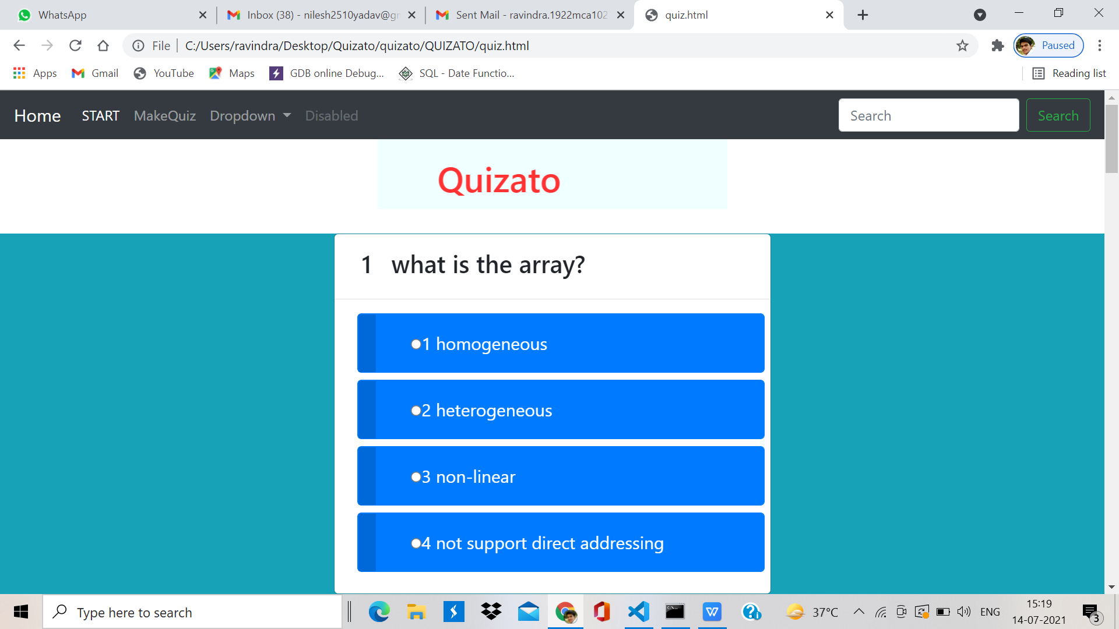
Quizato’s Design

Slide 18
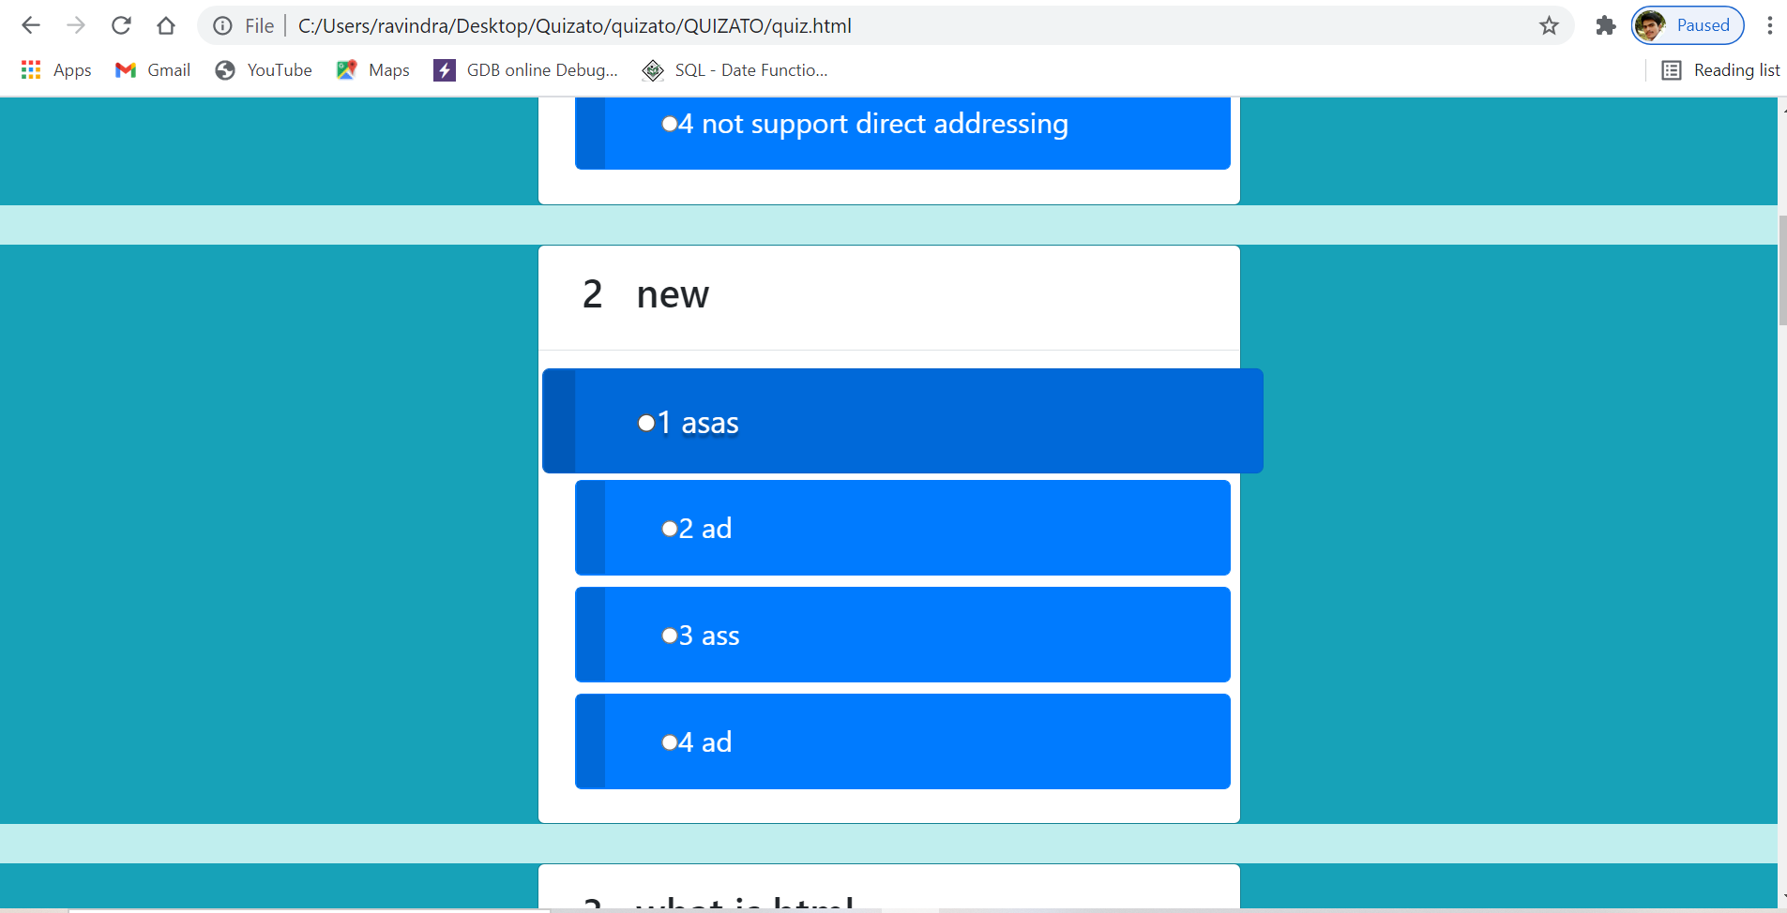
Quizato’s Design

Slide 19
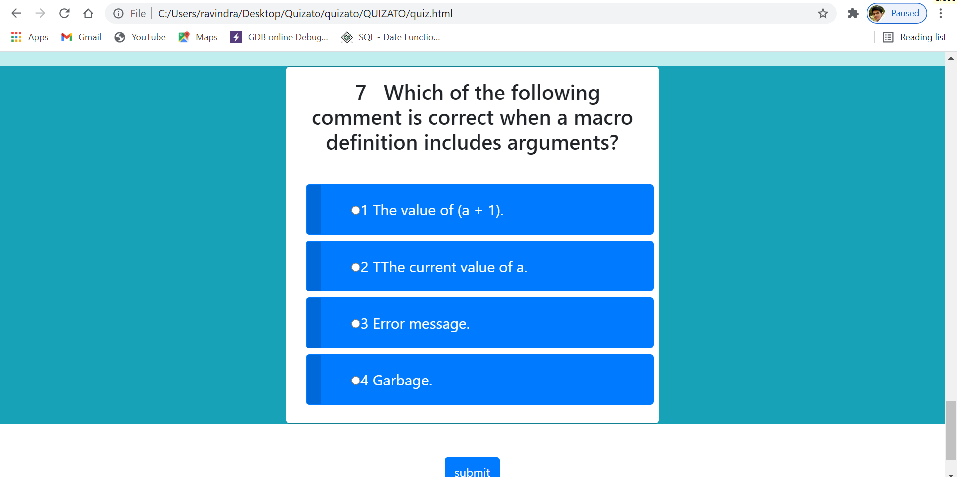
Quizato’s Design

Slide 20
Conclusion
User can attempt question without any instructor.
The user will be able to set a timer for the whole quiz or per question.
User can manage time for solve the question

Slide 21
Your suggestions are vey important and valuable to us.
Thank You
Regards
Ravindra Yadav
Ayushi Srivastava

